Slide 1
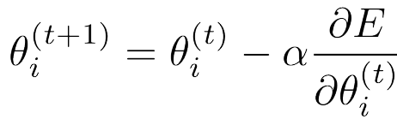
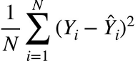
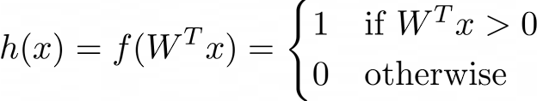
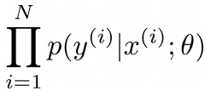
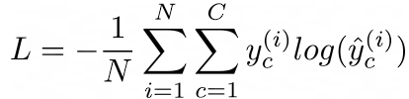

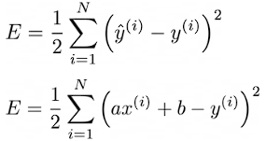

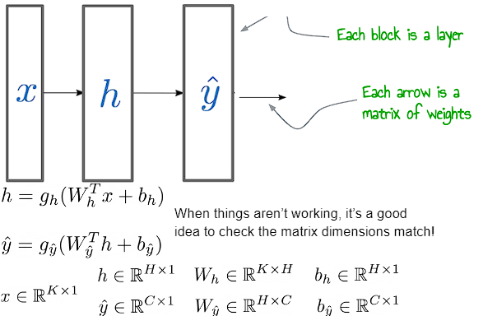
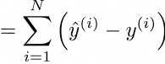

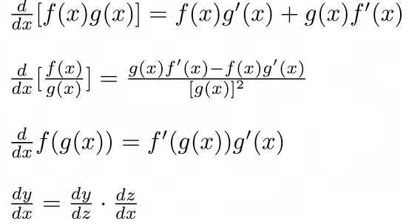
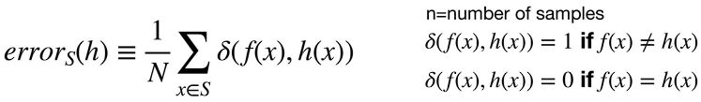
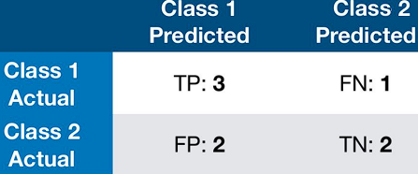
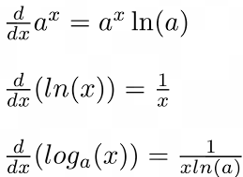




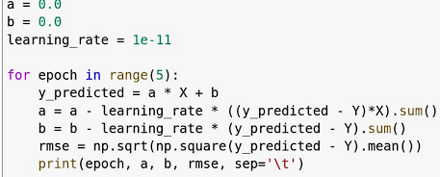
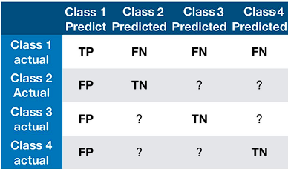

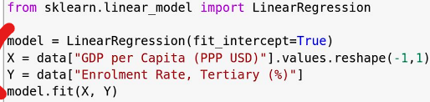
1) Introduction to ML – Terminology:
3 main paradigms based on input / type of feedback:
1) Supervised Learning – We give input variables, and correct output labels. We use a supervised learning algorithm to produce a model capable of taking in an input variable and guessing a correct output
e.g: Grade prediction based off some factors
1.1) Semi-Supervised learning: some data has labels, others don’t. We learn using the labelled to class others.
1.2) Weakly-supervised learning - inexact out labels
2) Unsupervised Learning - Supervised learning but no output labels are given. The aim here is to find patterns in the data / some hidden structure.
e.g: Classify dogs and cats (clustering). Dimensionality reduction is used to find the most important (underlying) labels / classification criteria
3) Reinforcement Learning - Input variables, no labels. We use our model and have it interact with some environment. If we did well, the algorithm is given a reward signal as feedback, so it can take that into account for next time. By the process of making predictions, we also improve ourself. Policy Search - find out which actions shouldbe taken and which shouldn’t.
4) Classifier: take input, produce a categorical output label. Binary / Multiclass (one of two /many output labels). Multi-label: choose all correct output labels out of many.
5_ Regressor: Given an input x we produce continuous real out y. Simple - one input, one out (e.g: f(x) = ax^n + b) e.g: house size -> house price Multiple - multiple inputs, one output (e.g coursework marks and past year marks, predict this year mark) Multivariate – 1+ input, multiple outputs (e.g: locate umbrella in the image, we’d output the coordinates of it which is multiple data values).
6) Model: our output of ML; aims to approx. the true func f. Takes as input x, produces y. To train it we feed in dataset D -> made up of input (and output labels in Supervised Learning), each tuple of which is a sample. X^{train} is the training input, Y^{train} the training out. Typically we split D into X^{train}, X^{test}, Y^{train}, Y^{test} at an 80:20 split.
Before we feed in data to our model, we usually want to preprocess it (normalizing, or other processing so make sure we get the right types of feature -> e.g: pixel data on an image rather than image) - Feature Encoding.
We also need to make sure that our dataset is balanced on output labels.
7) Curse of Dimensionality: More input vars <-> higher dimension space. As a result: data gets more sparse (hard to fit well without lots of data), higher computational complexity, and overfitting.
We should carry out Feature Selection (take subset of features) and feed those into our algorithms instead. We might use Feature Extraction – using base data to make new features to put in the model.
Bag of Words – common idea in ML (&NLP) we can represent our data as a hashmap of what we have, or a hashmap of all possibilities that we increment as we find occs. Simpler to handle as it produces a fixed length vector for the model. Doesn’t store word placement tho.
8) Lazy Learners - doesn’t actually learn anything - at test time it just looks at the data. Work is done at test time. E.g: Nearest Neighbours.
Eager Learning - Constructs a new explicit function based on the training examples and uses that at test time. Work is done at training time. E.g: Decision trees.
9) Non-Parametric Model: a non fixed form function –
e.g: Nearest Neighbour. Linear Model - we assume the data is linearly seperable, and a split based on some linear function Nonlinear Model - we assume it is some nonlinear function. E.g: a circle of data or quadratic. We could do Feature Space Transformation – e.g: if we have a circle of data, square it all and now we can use a linear classifier. We could also combine multiple linear classifers - decision trees.
10) The Bias Variance Tradeoff: Low Variance <-> High Bias. This is underfitting. High Variance <-> Low Bias. This is overfitting. We want to strike a balance.
2) K-Nearest Neighbours – Lazy Learning
Nearest Neighbour – simply pick closest.
K Nearest Neighbours – pick the nearest n points. Use these for classification / regression. For n-ary classifica-tion, we should avoid using kn points – as we may be unable to make a decision. Distance: L1/2/∞ Norm.
Weightings – closer points could be given greater weighting. 1/dist, or Gaussian Dist. k is a hyperparam-eter, doesn’t matter much in dist-weighted KNN since far points aren’t very relevant.
Simple / Powerful, but slow on large data sets. k-d trees or hashes that exploit locality help.
Ofc, we can use k-NN for regression and classification.
Curse of Dimensionality on k-NN: k-NN relies on dist metrics, won’t work well if using all features in high dimensional space, especially if some features are irrelevant. Solution: weight features differently / perform feature extraction and selection.
3) Decision Trees - Eager Learning
We focus on one piece of info / subset of sample and make a decision based on that. We repeat this process, which split the data with many linear classifiers, constructing a tree (basically constructing if-then rules). Pure: refers to a partition that is 100% correct. We either continue splitting until we have full purity leaf nodes, or until a specific depth. We can prune to – these techniques reduce overfitting.
3.1) Decision Tree Learning Algorithm – Greedy
1) Search for ‘optimal’ splitting rule on training data
2) Split data based on the chosen splitting rule
3) Repeat 1 & 2 on each newly generated subset.
When splitting, we want to make new datasets that are as pure as possible. This brings us to the following idea:
Information Entropy: Measure of uncertainty in a
random variable / average amount of info required to define a random state. High Entropy -> unstable / unpredictable. Low -> certain / predictable.
Since it’s defined by the average amount of info:
Continuous Entropy: Used for deep learning. PDF unknown -> use density estimation alg. Similar to CDF.
M1) Constructing Decision Tree with Entropy & IG
PlayTennis(d) outlook temp humidity wind
0 sunny hot high weak
0 sunny hot high strong
1 overcast hot high weak
1 rain mild high weak
1 rain cool normal weak
0 rain cool normal strong
1 overcast cool normal strong
0 sunny mild high weak
1 sunny cool normal weak
1 rain mild normal weak
1 sunny mild normal strong
1 overcast mild high strong
1 overcast hot normal weak
0 rain mild high strong
1) First calculate Entropy of each category:
D has 9 1s and 5 0s:
H(D) = -9/14 * log2 (9/14) - 5/14 * log2 (5/14) = 0.94
H(D_{sunny}) = -2/5 * log(2/5) - 3/5 * log2(3/5) = 0.971 H(D_{overcast}) = -4/4 * log(4/4) - 0 * log2(0) = 0
H(D_{rain}) = -3/5 * log2(3/5) - 2/5 * log2(⅖) = 0.971
2) Information Gain: difference between the initial entropy and the (weighted) average entropy of the produced subsets.
)
IG(D, outlook) = H(D) – (5/14 H(D_{sunny}) + 4/14 H(D_{overcast}) + 5/14(D_{rain})) = 0.94 – (5/14*0.971 + 4/14*0 + 5/14*0.971) = 0.246
Similarly for temperature, carry out steps 1 and 2:-
H(D_{hot}) = -2/4log2(2/4) – 2/4log2(2/4) = 1
H(D_{mild}) = -4/6log2(4/6) – 2/6log2(2/6) = .918
H(D_{cool}) = -3/4log2(3/4) – 1/4log2(1/4) = 0.811
IG(D, temp) = H(D) – (4/14*H(D_{hot}) + 6/14*H(D_{mild}) + 4/14 H(D_{cool})) = 0.029.
IG(D, humidity) = 0.151
IG(D, wind) = 0.048
The greatest IG is with outlook, so we choose that.
So, we split the data set into triples, since we have 3 categories in outlook.
PlayTennis(d) outlook temp humidity wind
0 sunny hot high weak
0 sunny hot high strong
0 sunny mild high weak
1 sunny cool normal weak
1 sunny mild normal strong
…………………
We see that the overcast category becomes pure (playtennis = 1 always), so it’s done. For the sunny and rain category we once again calculate Information Gain and find out how to split, and continue until full purity.
Remember H(D) refers to the column we’re interested in!
Decision trees are liable to overfitting. Fixes for this are:
1) Stop construction under a specific criteria (depth / items in subset)
2) Pruning: Delete a node – usually leaf ones, and check on a validation data set if our performance is better
3) Random Forests - Instead of training a single tree, we can train a collection of decision trees - a forest. Every tree in this forest will be trained using a different subset of the data from the training set, and with a random subset of the features. Each decision tree will as such focus on a different part of the data and inform a different type of decision. Then with each of these trees formed for each type of decision, we take a majority vote for the overall decision tree.
Regression Trees: Instead of a class label, leaf nodes predict a real valued num. We use training examples at leaf node to est. the out value (e.g. value that mins MSE) or learn a linear func of some subset of the numerical features. Use a different metric for split - Var reduction.
4) Evaluation
To ensure a good evaluation we MUST have a held-out test dataset. CANNOT be used in any part of the training!
4.1) Hyperparameters – model params chosen before training, e.g: k in KNN. We pick hparams for best results.
Correct Approach for Selecting Hyperparameters:
Split dataset in 3: training/validation/test. Between 60%/20%/20% and 80%/10%/10%. Try different hyperparameter values on the training dataset, then select the best according to the accuracy on the validation dataset. Perform the final evaluation on the test dataset. Once we found the best hyperparams, we can go back and use these to train a new model on the train/validation set combined from before. USING FOLDS = SHUFFLE.
4.2) Cross Validation – When we have small dataset, splitting into train/test/valid won’t give us great results.
Cross Validation fixes this for us:
1) Divide dataset into k (usually 10) equal folds
2) Use k-1 for training and for validation, 1 for testing
3) Iterate k times, each time testing on a different fold.
3) Performance on the k held out test sets is averaged.
Hyperparameters with Cross Validation:
1) At each iteration, use 1 fold for testing, 1 for validation and k-2 for training. Parameter tuning set may be small.
2) Separate 1 fold for testing, run an internal cross validation over the remaining k-1 folds to find optimal hyperparams (lots of computation). Each fold still has different hyperparams, but it’s chosen using more data.
4.3) Evaluation Metrics – Quantifying Model Quality
Confusion Matrix: Represents prediction info of model in a way
that’s easy
to evaluate.
Accuracy = (TP + FN) / sample size
Classification Error = 1 – Accuracy
Precision = TP / (TP + FP)
num correctly classified positive examples / total number of predicted positive examples
Recall = TP / (TP + FN)
num correctly classified positive examples / total number of positive examples
Precision and Recall are linked:
High recall, low precision: Most positive examples are correctly recognised (low FN) but many false positives.
Low recall, high precision: We miss many positive examples (high FN) but those we predict as positive usually actually positive (low FP).
F-Measure: Combines Precision and Recall into 1 score:
F₁ = (2 . precision * recall) / (precision + recall)
F_{B} = (1 + B²)*(precision*recall) / ((B² *precision)+recall)
F₁ puts equal importance on precision and recall. The higher B is, the more importance we put on recall.
If we are doing
multiclass
classification,
we can extend
our 2D Matrix:
We define a
class (class 1
here) as our
positive, the rest are negatives.
Accuracy = num correctly classed examples / total
Macro Averaged Recall/Precision/F-Measure:
Compute the metric for each class and average them.
Detecting issues of different types -> use F Measure. Amounts -> RMSE. Type of X -> accuracy.
Micro vs Macro Averaging:
Macro Averaging: Taking the average on a class level.
Micro Averaging: Taking the average on an item level (e.g: adding the TP, FP, TN and FN) before calculating the metrics.
4.3.1) Evaluating Regression Models
We can use MSE, or RMSE.
Accuracy isn’t the only
important metric – speed,
scalability, simplicity (&robustness) and explainability of predictions are also very important.
4.4) Dealing with imbalanced datasets
In a balanced set, we have an equal number of positive and negative samples (equal number of class 1 and 2). Imbalanced, unequal. Because of classes not being equally represented, accuracy goes down, and precision and F1 are massively affected for the underrepresented classes. We may even just never predict a minority class!
Things of note:
1) Accuracy can be misleading, as it simply follows the performance of the majority class.
2) Macro-averaged recall can also help detect if one class is completely misclassified, but it does not give us information about FP
3) F1 is useful but can also be affected by the class imbalance problem. We are not sure if the low score is due to one class being misclassified or class imbalance.
4) We should look at several metrics, along with the confusion matrix
Solution: Normalize our counts by downscaling the majority class / upscaling the minority class. This helps balance the evaluation, but the model is still formed from an imbalanced distribution
4.5) Overfitting & Underfitting
Overfitting: Good performance on the training data, poor generalisation to other data.
Underfitting: Poor performance on the training data and poor generalisation to other data.
Overfitting can occur when: The model we use is too complex, the examples in the training set are not representative of all possible situations or the learning is performed for too long.
4.6) Confidence Intervals
True error of the model h = probability that misclassifies a randomly drawn example x from distribution D:
The sample error of the model is:
An N% confidence interval for some parameter q is an interval that is expected with probability N% to contain q. E.g. a 95% confidence interval [0.2,0.4] means that with probability 95% q lies between 0.2 and 0.4.
Given a sample S with size >= 30, we can say with N% confidence the true error lies in the interval:
As n -> infinity, the confidence interval shrinks (as we can be much more precise); the interval would just be [0.22]
4.7) Testing for Statistical Significance – 5% = sig.
Consider the distributions of the classification errors of two different classifiers derived by cross-validation.
The means of the distributions aren’t enough to say one of the classifiers is better. We have to statistically test it.
1) Randomisation test: randomly switch some predictions from both models and measure how often the new performance difference is greater or equal than the original difference.
2) Two-sample T-test: estimate the likelihood that two metrics (e.g. classification error) from different populations are actually different.
3) Paired T-test: estimating significance over multiple matched results, for example classification error over the same folds in cross-validation
H₀: the two algs/models perform the same
Tests return a p-value: P of obtaining observed performa-nce differences (or more), assuming null hypothesis corr-ect. Small P = more chance the dists are different. Performance difference is statistically significant if p<0.05. A p-value of > 0.05 does not mean that the two algorithms are similar. Simply that we cannot observe a statistical difference. For instance, collecting more data can change the p-value in one direction or the other.
4.8) P-Hacking
P-Hacking: the misuse of data analysis leading to finding patterns in data when there is actually no significant evidence of underlying effect.
Happens when we run lots of experiments and only pay attention to significant ones .
If we define significance as <5% then we have a 5% chance of a significant result being a false positive.
To defend against P-Hacking we can calculate the adaptive P Value:
1) Rank P values from experiments: p₁ <= p₂ … <= p_{M}.
2) Calculate the Bejamini-Hochbery critical exponent for each experiment: z = 0.05 i/M
3) Significant results are the ones in which
p < critical exponent.
5) Artificial Neural Networks
ANNs: architectures of connected neurons, optimized with Gradient Descent.
Deep learning: NNs with hidden layers.
NNs are powerful as they allow combining different types of info – e.g: take images as input, output generate descriptive text.
Loss Functions: Our loss function is MSE, which is easily differentiable.
Derivatives:
1) Derivative of MSE w.r.t: a:
2)Derivative of MSE w.r.t: b:
Differentiation rules:
5.1) Gradient Descent
Update params repeatedly by taking small steps of size α:
We repeatedly update: a = a – α*dE/da
We update b: b = b – α*dE/db
Pseudocode for Gradient Descent: 5 epoch
Sci-kit learn does it in 1 line:
Assume: Gradients can be computed. All network functions & loss are differentiable.
5.2) Artificial Neurons – used for binary classification. Take many inputs as values
and depending on it they fire:
g = activation function. b = bias.
Weights = the thetas. x_{s} = features.
5.2.2) Perceptron
Early version of artificial neuron; activation function is:
α = learning rate, Θ = weight, x = feature
Perceptron Learning Rule:
Θ_{i} <- Θ_{i} + α(y-h(x))x_{i}
If the desired output y is equal to our prediction h(x) then we keep the weight the same. Else, we decrease or increase as needed as you see.
Because the activation is sharp and non-differentiable we don’t use perceptrons in complex NNs.
5.3) Multi-Layer NNs
Neurons are powerful when we connect them in layers to form an NN. We can connect Neurons in parallel – each one will learn something different, and also connect them in sequence so that later neurons learn higher order features (features of features from the previous layer. )
Multilayer Perceptrons (MLPs - not actually percepts.) can model an arb. fun. over an inp.
NNs are typically depicted in block layers.
5.4) Activation Functions
1) Ligmoid (Logistic) Function
g(z) = 1 / (1+e^{-z}). Between 0 & 1 -> good.
Logistic Regression: Combining linear regression with the logistic function – by passing the results of linear regression into the sigmoid function. This allows us to do binary classification.
2) Tanh: (e^{x} – e^{-x}) / (e^{x} + e^{-x})
Similar shape to the sigmoid but ranges between -1 and 1. Input 0 also corresponds to output 0.
3) ReLU(x) = 0 for x <= 0 | x for x > 0
4) Softmax scales vals to a prob dist. Largest input is large, the rest have a huge dropoff. Like max but differentiable:
ReLU is typically used for deep networks, Tanh and sigmoid work well and can be
more robust.
For the outer layer we
need to pick an
activation that
depends on the task
1) classify from 2
options: sigmoid/tanh
2) Predicting
unbounded score -> linear
3) Prob dist or
Multiclass classification-> softmax
5.6) Loss Functions
We need a loss func to minimize for our NNs
We iteratively update parameters and our loss function changes like this at each step:
Loss for regression, MSE.
5.6.1) Loss Functions for Classification
Need to maximize likelihood of the network
assigning correct labels to all inputs. e.g:
max:
P(A and B) = P(A) * P(B) if A and B are iid.
If we take the log of the above we get a loss function as below:
Where C is the set of possible classes and y^c(i) is the predicted probability of class c for datapoint i and N is number of prediction
Applications:
Problem Type OutActivation Loss
1) Future Stock Prices -> regression -> linear output -> MSE
2) Stock Prices Up/Down -> Binary -> Sigmoid -> Binary crossentropy
3) Speech recognition -> multi-class -> softmax -> categorical crossentropy
4) chemical properties -> multilabel ->
sigmoid -> binary crossentropy
Misc: Bad performance on train/test -> bug/underfitting. Good on train, bad test -> overfit/bug. Too good on test -> maybe bug / accidentally split data poorly so it received some of the test info
5.7) Batching
Batching: combining the vectors of several datapoints into one matrix to improve speed and reduce noise, e.g: combining a 1x2 and 2x3 matrix into a 1x3 vector by
multiplying them out.
5.8) Forward Passes
Forward -> Taking the input from the previous layer and feeding it through this
layer. It’s done by multiplying the previous input with this layer’s weights, adding this layer’s biases, and then feeding
that into the activation of this layer.
Product Rule:
Quotient
Rule:
Chain Rule:
Chain Rule:
M2) Confidence Intervals
Case 1) We know the true variance of a population. We work out the sample mean, and it is distributed as:
X ∼ N(x, σ²/n)
The formula is [x - z σ / n, x + z σ / n] where z is the two tailed standard normal value at the right confidence interval.
Case 2) The true variance is unknown. We have to obtain the bias corrected variance:
S_{n-1} =
Set DoF = ν = n − 1.
For a double ended confidence (100 − α)%, we compute t_{ν=n−1, 1−α/2} to find the critical values.So the formula is:
[x – t_{v=n-1, 1-a/2} S_{n-1} / √n,
x + t_{v=n-1, 1-a/2} S_{n-1} / √n]
When using the tables for t values, we use the size we want (e.g 0.975 for 95% double-ended confidence interval), and then use the degrees of freedom (n − 1).

Slide 2
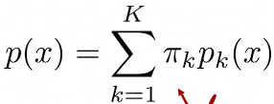
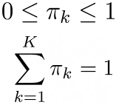
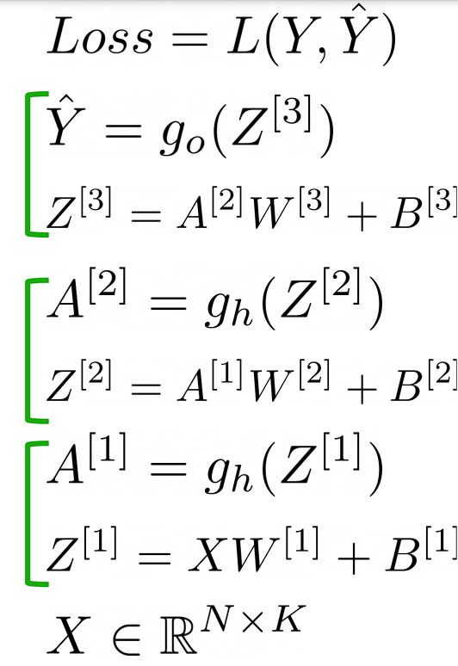
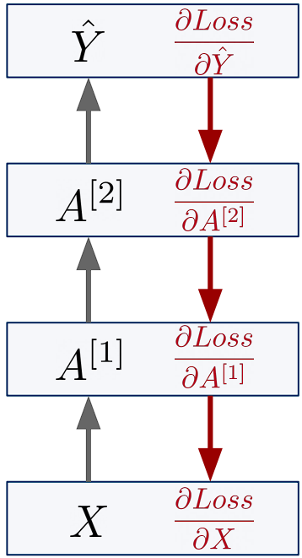
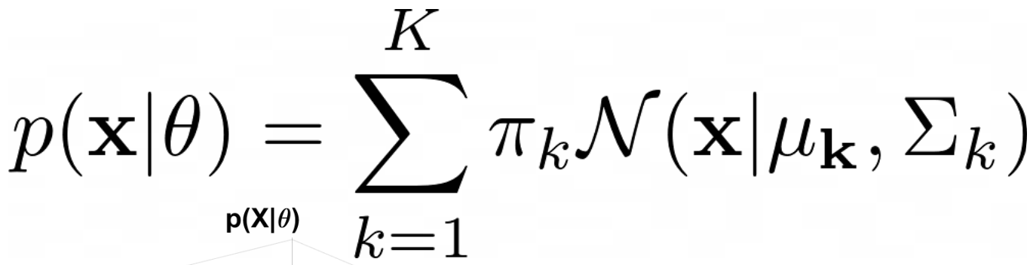
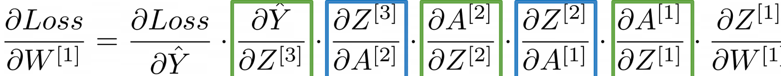
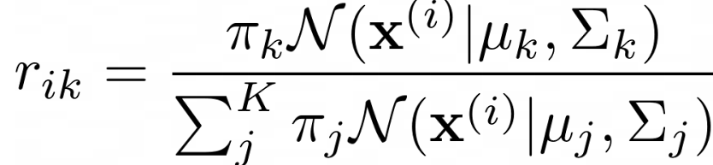
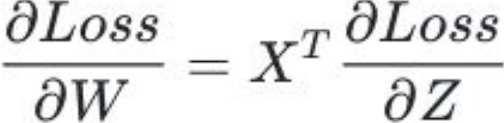
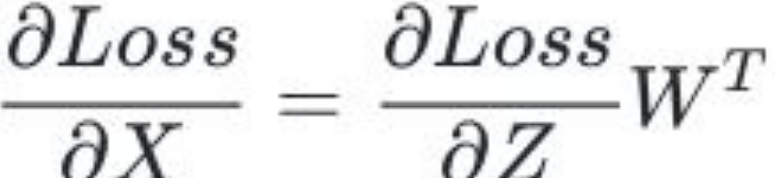
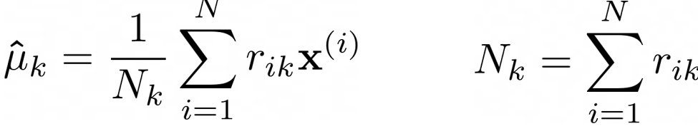
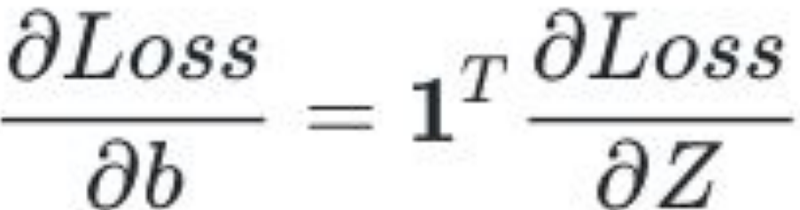
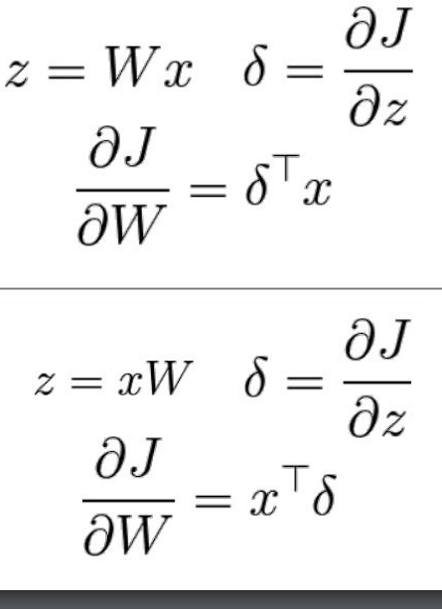
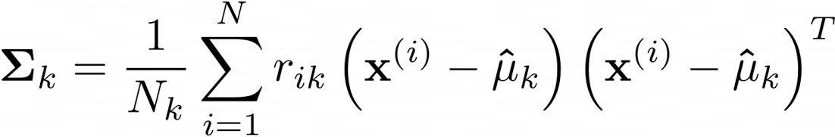

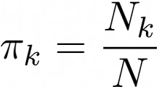
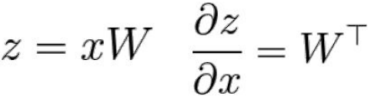

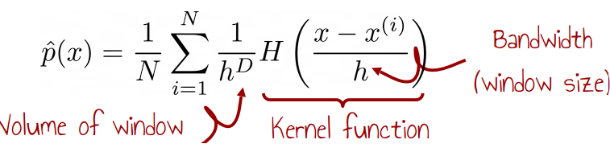
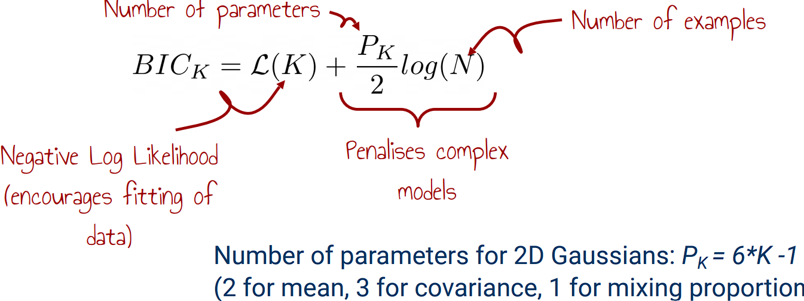
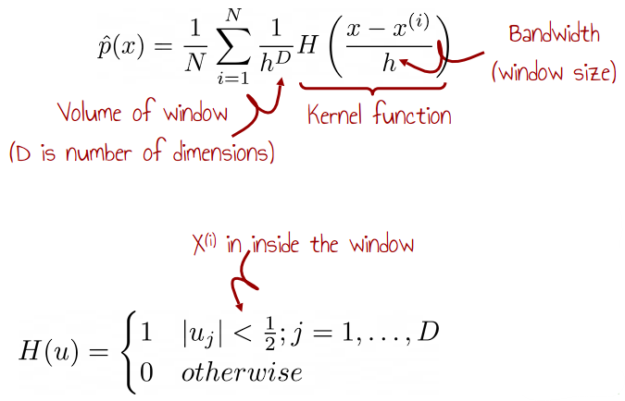
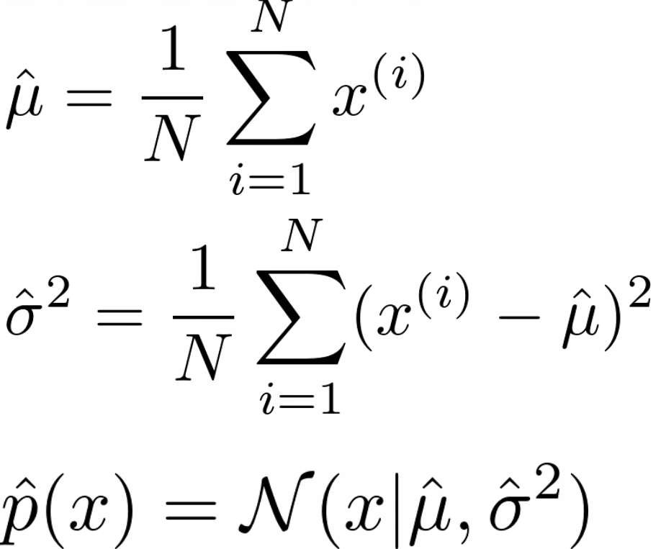
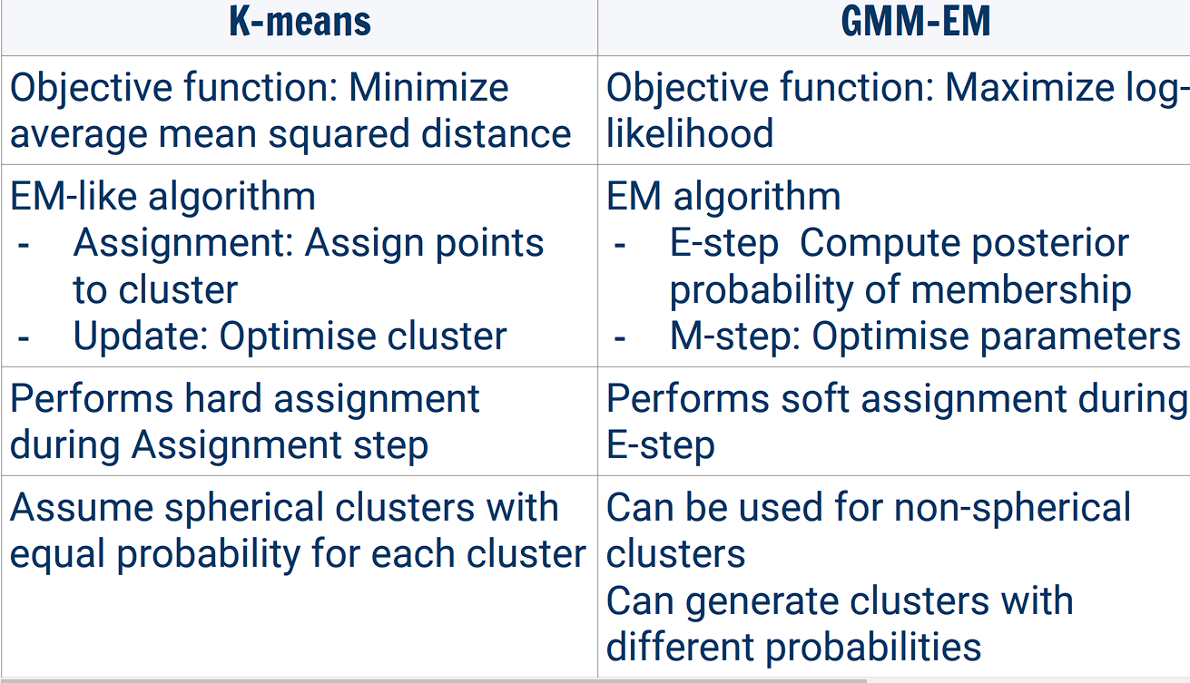
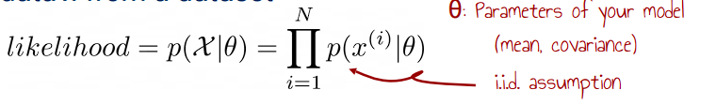
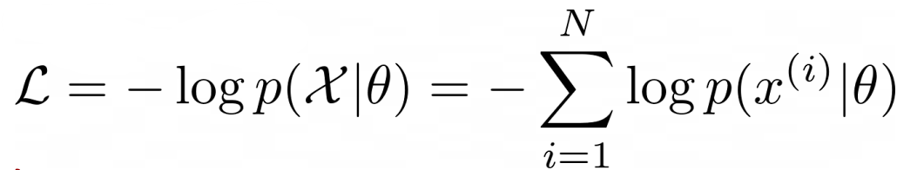
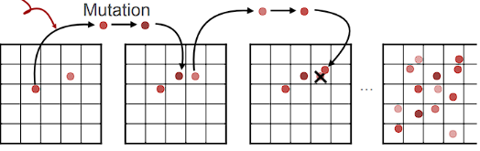
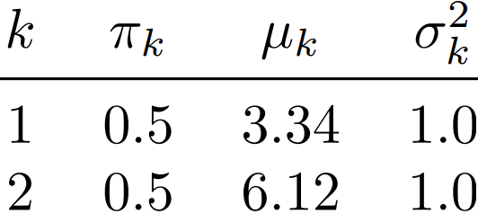


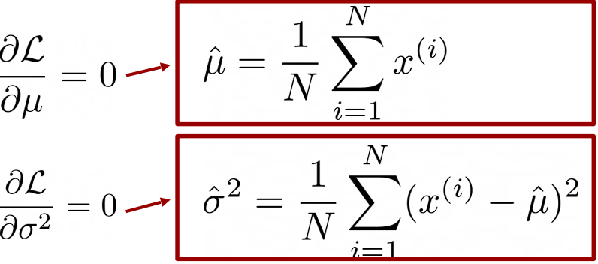
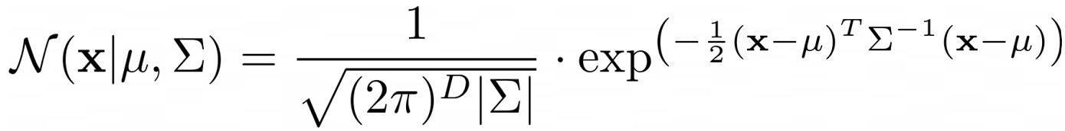
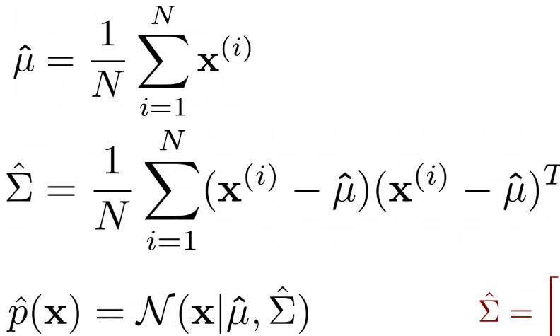
5.8) Backpropagation
When training the NN model we want to update our parameters in the network (Ws and Bs). Grad Desccent would be too expensive. Backpropagation is used to break these calculations down by calculating the partial deriv (PD) of the loss of a particular layer based on the PD of the layer above. Iteratively, can compute all. To calculate these PDs we use the chain rule: y = g(z); z = f(x).
dy/dx = dy/dz * dz/dx (chain rule) both of which we can compute. Going further:
To find dLoss/dW^{[1]}
we compute
dLoss/dZ^{[1]} *
dZ^{[1]}/dW^{[1]}
We can compute
dZ^{[1]}/dW^{[1]} straight
away, (since we have
an eq that associates)
them.
Loss however
continually chains
back and simplifies
to the equation below:
1) The derivative for an input to layer:
Plug in X^{T} ie: the input from above
Layer.
2) The derivative with respect to the weights:
Plug in W^{T} ie: the input from the
above layer.
3) Biases:
Here are partial derivatives for vectors and matrices:
For Activation Functions: dLoss / dZ = dLoss / dA o g’(Z) where o is element wise multiplication of the matrices (Hadamard Product).
Derivatives of Activation Functions:
Linear: g(z) = z, g’(z) = 1.
Sigmoid: g(z) = 1/(1+e^{-z}), g’(z) = g(z)(1-g(z))
Tanh: g(z) = (e^{z}-e^{-z})/(e^{z}+e^{-z}), g’(z) = 1-g(z)²
ReLU: g(z) = z for z > 0, g’(z) = 1 for z > 0.
g(z) = 0 for z <= 0, g’(z) = 0 for z <= 0.
M3) Forward Pass, MSE, Backward Pass & Gradient Descent
W₁ = [0.1 0.2] b₁ = [0.2 -0.1] W₂ = [0.5] b₂ = [0.4] X = [0.2 -0.4]
[0.3 0.4] [0.6]
Input layer of 2 neurons, hidden with 2 & sigmoid activation, output with 1 neuron & linear activation (ReLU).
1) Calculate the output: Put X in h₁ = sigmoid(W₁X + b₁). Put h₁ in
y^ = ReLU(W₂h₁ + b₂ ) -> return y^.
sigmoid(W₁X + b₁) = sigmoid([0.1 -0.22]) = [0.525 0.445] = h₁ ->
ReLU(W₂h₁ + b₂) -> 0.634.
2) Calculate the MSE given target 1.5: (0.634-1.5)² = 0.7576
3) Calculate the gradients for the weight matrix W₁ and bias vector b₁
dLoss/dy^ = d(y^-y²)/dy^ = 2(y^ - y²) = 2(0.629622-1.5) =
-1.740756. (Just plug in the loss function)
dLoss/dh₁ = dLoss/dy^ . W₂^{T} = (-1.741) * [0.5 0.6] = [-0.87 -1.044]
(derivative of the loss to respect to hidden layer, is the derivative of the loss multiplied by the gradients of that upper layer (weight)).
dL/dz₁ = dL/dh₁ o σ’(z₁) = dL/dh₁ o σ(z₁) o (1- σ’(z₁)) = dL/dh₁ o h₁ o (1-h₁) = [-0.87 -1.044] o [0.525 0.445] o (1 – [0.525 0.445]) =
[-0.217 -0.25798] (derivative of activation)
dL/dW₁ = X^{T}dL/dz₁ = [0.2 -0.4]^{T} . [-0.217 -0.25798] =
[-0.04 -0.05]
[0.0868 0.1] (derivative of weight)
dL/db₁ = 1^{T}dL/dz₁ = [-0.217 -0.25798]
4) Calculate the updated values for W₁ and b₁ after doing 1 step of stochastic gradient descent with learning rate 0.1.
W₁ = W₁ – α . dL/dW₁ = [0.1 0.2] – 0.1[-0.04 0.05]
[0.3 0.4] [0.0868 0.1]
= [0.104 0.205]
[0.291 0.39]
b₁=b₁ – 0.1 dL/db = [0.2 – 0.1] -0.1[-0.21 -0.258]=
[0.2217 -0.742]
5.9) Gradient Descent: pseudocode:
1. Initialise weights randomly
2. Loop until convergence:
3. Compute gradient based on the whole dataset (before updating weights!!)
4. Update weights
5. Finish
We work on the whole set for 1 gradient descent step!
Stochastic Gradient Descent:
1. Initialise weights randomly
2. Loop until convergence:
3. Loop over each datapoint (susceptible to noise):
4. Compute gradient based on the datapoint
5. Update weights immediately on that datapoint 6. Finish
Even more costly! But we update weights immediately. Also noisy, so descent steps might veer around a bit.
Mini-batched Gradient Descent: a nice midground
1. Initialise weights randomly
2. Loop until convergence:
3. Loop over batches of data points
4. Compute gradient based on the whole dataset
(before updating weights!!)
5. Update weights
6. Finish
5.10) Optimizing Neural Networks - Hyperparams.
loss surfaces for NNs complex; finding optimum is hard.
1) Learning Rates: Too low, model will take too long to converge. Too high, steos over the optimal values.. Adaptive learning rates: Have a different learning rate for each parameter. Bigger steps if param not updated much recently, smaller steps if many big updates. Adam / AdaDelta from PyTorch, Learning rate decay: Easily implementable adaptive learning rate: take smaller steps as we get closer to minimum, so we don’t overshoot. Decay after every epoch / after a certain number of epoc-hs when performance on the validation set not improved.
2) Weight init – zeroes, normal distributed or xavier –
n_{j} = neuron
cnt prev layer
n_{j+1} = neuron
cnt next layer
3) Normalization – min max scaling: smallest is scaled to [a, b] -> e.g [0, 1]. X’ = a + (X–X_{min})(b-a)/(X_{max}-X_{min})
Standardization – scale data to have mean 0, stdev 1:
X’ = (x – mean) / stdev
This helps as weight updates are proportional to input.
5.11) Overfitting – happens with too much layers / neurons. Many trainable params -> model can memorise data instead of learning informative patterns. If underfitting on the training data -> increase the number of neurons/layers. If overfitting too fast reduce the number of neurons/layers. (forced to learn higher level knowledge that generalises)
Other techniques to reduce overfitting:
1) Early Stopping: Evaluate on validation data at every epoch, always store the best model so far, stop training when performance hasn’t improved enough for some epochs. 2) Regularisation: adding some info or constraints to stop the model from overfitt. ie: penalising size of the model weights. L2 regularisation: adding squared weights to loss function. Pushes tiny weights towards zero, penalized large weights -> encourages sharing between features, as small weights are not penalised much. L1 regularisation: adds the absolute weights to the loss function. Encourages feature sparsity, the model will keep only the most important features.
3) Dropout: During training, randomly set some neural activations to zero. Typically drop 50% of activations in a layer. During testing, use all the neurons (but scale the activations). Form of regularisation - prevents the network from relying on any one node.
M4) EMM-GM Expectation & Maximization Steps
a) E-Step: Compute the
responsibilities r_{ik} for each
example i and component k.
For r₁₁: (0.5 * N(x¹|u₁, σ₁)) (Σ²_{j=1}0.5 N(x¹|u_{j}, σ_{j})) =
N(x¹|u₁, σ₁²) = 0.01431 N(x¹|u₂, σ₂²) = 0.1955
-> 0.007155 / 0.01431 + 0.1955 = 0.0353.
r₁₂: π₂N(x⁽¹⁾|u₂, σ₂²) / π₁N(x¹|u₁, σ₁²) + π₂N(x⁽¹⁾|u₂, σ₂²) = 0.9647.
6.3) Mixture Models – using one normal dist is a bit biased.
We usually mix Gaussian Distributions:
Gaussian Mixture Model (GMM):
Sigma is stdev
6.4) GMM-EM – weighted mixture of Gaussians.
GMM’s can model complicated data distributions but have more parameters to optimise! We can’t easily fit GMMs to training data, if we maximize likelihood updating each parameter affects the others anyway. We use EM:
6.4.1) Expectation Maximization –
1) Initialisation - Choose a K; randomly init parameters.,
each between 0 and 1, and they sum to 1.
2) E-Step - Compute the responsibilities for each training example xi and each mixture component k:
3) M-Step – update the mean and covariance and mixture proportion of all mixture components:
4) Repeat Steps 2 and 3 until convergence. Ie: params remain similar, or likelihood does, after each iter. This method converges to local optimum.
6.4.2) Hyperparameter Tuning for GMM-EM
1) To find the optimal number of mixtures we minimise the Bayesian Information Criterion (BIC):
2) Or we can just use Cross Validation…:
(Same procedure as K-means): Split into training and validation sets. Run GMM-EM on the training set with different K’s and evaluate the likelihood on the validation set.
6) Unsupervised Learning - don’t have correct output labels supplied
6.1) Clustering & K-Means
Applications: 1) Vector Quantization - Group continuous features into prototypes (to represent data in terms of less bytes -> e.g: group colours and then transform an image into a lower colour depth image) We can map similar images into a hashmap (bag of visual words) -> and then this allows us to cluster. 2) Image segmentation
3) market segmentation 4) social network analysis
K-Means helps us form clusters; pseudocode:
1) Initialise – pick some points in grid to be “centroids”, often random
2) Assign each data point to the closest “centroid” as its label.
3) Update each “centroid” by moving it to the mean point of all the data points that have its label. 4) Repeat steps 2 and 3. If we have converged then stop, and now we have classified our data. AKA, if:
∀k|u_{k}^{t} – u_{k}^{(t-1)}| < e then stop!
If: if the difference between the means for each cluster is low enough, for some hyperparam e.
6.1.1) Selecting K: 1) The elbow method: Run K-means multiple times with different K’s (e.g., from 1 to 10) Keep track of cost L(Ө) for each K value. Select K where the rate of decrease sharply shifts
2) Cross Validation: The dataset is split in N folds, and N-1 folds are used to compute the centroids positions with k-means. Then, we compute the average score (same as before) on the validation datasets. We do this for various values of k and we pick the best configuration. Select K such that further increase in the number of clusters leads to only a small improvement in the average score_k.
Adv+: Simple, popular and efficient. Neg-: Must find a K. Finds a local optimum; sensitive to initial centroid positions. Requires dist func (for categorical we use K-Modes). Outliers. It is only suitable for discovering circular clusters. Solutions: run model many times, pick lowest cost. Use a better initialization like K Means++
6.2) Probability Density Estimations (PDEs)
Density Estimation: estimate p(x) from data (find the underlying distribution) Applications: Anomaly/novelty detection: QC in manufacturing, Credit card fraud detection. Generative models (model the distribution of the class p(X|y) (able to generate new samples from the label) unlike discriminative models that generate p(y|X) (NN, linear regression, decision trees)
6.2.1) Non Parametric Approaches to PDEs
Non-parametric method - no assumps about form! Follows the data (low bias) like k-nearest neighbours. Num of params grows with data.
1) Histograms - Group data into contiguous bins Count the number of occurrences in each bin (and normalise). Decreasing the number of bins smooths out p(x) (less bias) but ofc more variance.
2) Kernel Density Estimation - Compute by looking at training examples within a kernel function H (or Parzen window - sliding window)
H can also be a Gaussian or the below. Gaussian leads to a smoother p(x). Higher h (BW)=smoother.
6.2.2) Parametric Approaches
Makes simplified assumptions about the
form. High bias -> Low Variance. Num of
params is fixed We can do this by using
The Law of Large Numbers as on the
Right. Can also be done with multivariate
Normal distribution.
6.2.3) Likelihood – tells us how good a model is. Model captures the probability of generating or observing data x within an interval. Likelihood: measures the probability of observing data x from a dataset
Negative Log-Likelihood is often used -> becomes a min problem:
We just find the derivative of this (solve for 0):
Doing the long derivation gives you these values for mean/var when the partial derivatives w.r.t them is 0:
σ² = Σ(x-u)²/N (population variance)
s² = Σ(x-x_{bar})²/n-1 (sample variance)
7) Evolutionary Algorithms: An Optimisation algorithm for black-box func (when we don’t know the gradient) – like reinforcement learning, BB opt problems: Robot learning, Hyperparameter tuning, games.
1) Evolutionary Strategies 2) Evolutionary Programming (Evolution of FSMs) 3) Genetic algos (Design of complex robust systems) 4) Genetic prog (Evolution of progs), 5) Estimated Distribution algorithms (stat model of pop) 6) Multi-objective algs (Simultaneously opt. several objs.)
The Core Idea: Init -> 1) we have a population 2) We evaluate it with some metric and rank the mem-bers 3) The worst members are removed from the population. 4) The best ones are kept (fitness func-tion) and “reproduce” (crossover parameters). We also introduce “mutations” (randomness). 5) Repeat.
Genetic algos are defined in terms of three main operators:
1) Selection operator: Selects solutions that reproduce 2) Crossover operator: mixes the parents’ genotype. 3) Mutation operator: Type/frequency of the variations applied genotype after reproduction
Differences between the algorithms (Genotype, operators):
1) Genetic algorithm: Genotype: binary string of fixed size (ex. 01001010) Crossover: swap portions of the string Mutation: Random flip of bits
2) Genetic programming: Genotype: Program represented as tree (often in LISP) Crossover: Swap portions of trees Mutation: Change the symbols in the tree 3) Evolutionary Strategies: Genotype: String of floats/doubles Crossover: usually not used Mutation: Draw from a Gaussian distribution
Nowadays, we use Evol Algos that mix all approaches: 1) Genotype are often strings of floats/doubles
2) These genotypes can be used to encode graphs 3) Heterogenous list of parameters
4) Large number of variants of the operators.
The following things are needed for a genetic algo. Steps can be adapted to the prob w/hyperparameters
7.1) Fitness Functions – represents the problem to solve. Solving the problem = maximizing fitness. Problem specific, teaching a robot to walk: F(x) = walking speed, robot throw an object: F(x)=-dist(x, y)
7.2) Genotypes/Phenotypes genotype: genes - what’s passed; phenotype: genotype manifestation.
7.3) Selection Operators – Many possibilities:
1) Biased Roulette Wheel - Individuals are given a portion of the circle. Higher fitness -> larger proportion of the circle. We generate r = a number between 0 and 1, p_{i} = probability of selecting an indiv from the pop, and select the individual q_{i} such that r lies between probability portion interval of q_{i-1} and q_{i}.
2) Tournament Selection: 1) Randomly draw two individuals from the population 2) Select the best out of the two 3) Repeat this until you have enough parents.
Variant: Drawing multiple individuals Disadvantage: Doesn’t always select best (of both)
Advantages: Considers only relative values of the fitness; Easy to parallelise (of both)
7.3.1) Elitism - best performers stay alive for next gen. Often 10%. Each gen’s best >= prev gen’s
7.4) Crossover Operators – Combine traits of parents. e.g: for Strings, pick a cutoff point, the left characters are taken from parent 1, right ones from p2.
7.5) Mutation Operators – Explore nearby solutions. For each genotype bit, generate a num between 0 & 1 and if below a specific thresh, flip bit. Often m = 1/size(genotype).
7.6) Stopping Criterion – specific fitness level/predefined num gens/best fitness stagnates for time.
7.7) Evolutionary Strategies – working with real numbers. Genotype = list of reals Parent selection: Uniform Mutation: generated from a Gaussian
Similarities: Notion of population and selection Differences: Genotype, no crossover, selection method. We use μ and λ: 1. randomly init pop of (μ+λ) indivs 2. Eval the pop
3. Select μ best indivs as parents (x) 4. Generate λ offspring: y_{i} = x_{j} + N(0, σ), j = randi(μ) 5. pop = union of parents and offspring
Often λ/μ is around 5. Hard bit is picking σ -> big -> moves to solution quick, struggles to refine. Small
-> slow, affected by local optimums more. Solution: adaptive learning rate -> add σ to the genotype.
7.8) Novelty Search – useful when we have a large solution space with diversity in alternative solutions
Novelty Archive: contains all solutions we’ve seen so far. For a new solution, compute the distance matrix between our it and the archived solutions. Novelty Score: average dist.
Behavioural Descriptor: characterises aspects/types of the solutions. Not necess-arily linked to the task - several solutions are likely to have the same behavioural descriptor, but with different fitness values. We compute features on our solutions and compute distance in terms of these. They describe the final solution. Novelty search is good when we want to explore the entire search space – we might need to. It also means we don’t get stuck in the local minima!
7.9) Quality Diversity Optimization – learning in one optimization process a collection of diverse high performing solutions. Process: Collection -> Stochastic Selection -> Random Mutation -> Evaluation -> Tentative Addition to Collection. Evaluate: fitness function + behavioural descriptor
7.10) MAP Elites - Multi-dimensional Archive of Phenotypic Elites. Simple, yet very powerful algorithm. Discretises the Behavioural Descriptor space in a grid and tries to fill it with the best solutions. Addition: Each new solution goes to the cell corresponding to its BD. If the cell is empty the new solution is added to the grid. If the cell is already occupied, the solution with the best fitness is kept. Hyperparams: size of the cells (or resolution of the grid) Advantage: Easy to implement Drawback: Density not necessarily uniform. We quantify performance by:
1) Diversity of solutions in the container - archive size. 2) Performance of solution in the container - max, or mean fitness value. 3) Convergence speed of these two points. 4) QD-Score summarizes this: the sum of the fitness of all the solutions in the archive (assumed to be strictly positive).
Framework for QD Algorithms: Selector used to select the individual that’ll be mutated and evald in the next gen. Simplest and effective: Uniform random selection over the solutions in the container. Or, the selection can be proportionally biased according to a score – fitness, novelty, curiosity score. There are two different ways to store the solutions in QD - a grid or an unstructured archive.
Applications:
1) Walking in every direction - QD algorithm: unstructured archive + random uniform selector, Behavioural descriptor: X/Y position of the robot after 3 seconds, Fitness: angular error at the end of the trajectory wrt. an ideal circular trajectory
2) Pushing a cube: QD algorithm: MAP-Elites (grid + random uniform selector), Behavioural descriptor: final position of the cube Fitness: Energy efficiency of the movement/
3) Automatically generated levels for games like bullet hells / dungeon. 4) Image generation
Multivariate
Gaussian
Distribution:
5.11) Checking your Gradient
1) from the weight diff before/after gradient descent:
2) Change weight a bit and measure loss diff:
Both methods should yield similar values of dL(w)/dw
Note that we should end with k items for each in the original dataset of size N, where k is the number of examples.
b) Maximisation step: Compute the mean µ_{k}, variance σ²_{k} and mixing proportion π_{k} for each component k
given the responsibilities you computed earlier in the E-step:
u₁, σ₁², π₁ we calculate using the given formulae. Note that N = samples in given dataset.
5. Suppose the parameters for the GMM in Q4 are fitted as follows after convergence:
Compute the probability density p(x = 3.13|π1, π2, µ1, µ2, σ₁² , σ₂²) given the GMM above.

